Slide 1
Analysis of Maternal Death Surveillance and Response Data 2017-2021: Causes and Contributing factors in Addis Ababa, Ethiopia
Sisay T, Tolcha K, Abdulnasir A, Abrham L

Slide 2
Presentation outline
Background
Methods
Results and Interpretations
Conclusions
Recommendations
Acknowledgement

Slide 3
Background
Maternal death is a complex event to understand as it’s interwoven with different determinants:
Healthcare system (Hamal M, 2022), Socio-Cultural (Mother R, 2012), Economic (Adgoy ET, 2018), Environmental (Kaur M et al 2018), and Political (Melberg A et al 2019) factors
MMR is one of the SDGs indicator

Slide 4
Background…cont’d
Ethiopia is amongst countries with the high burden:
Fertility rate of 4.6 per women (EDHS 2019) and
Life time risk of maternal deaths 1 in 55 (WHO 2017)
MMR of 412 per 100,000 live births (EDHs 2016)
According to EDHS 2016, Addis Ababa has reproductive health service coverage of over 96%

Slide 5
Background…cont’d
This study was conducted to describe mortality data and identify the causes and contributing factors of maternal deaths in Addis Ababa, Ethiopia

Slide 6
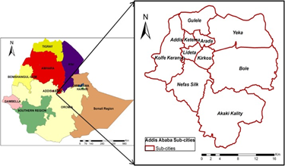
Methods
Study area:
Addis Ababa, capital of Ethiopia
Has a total population of 3.8million: 1.2 million are women in 15-49 years (CSA, 2013)

Slide 7
Methods…cont’d
Data source:
Five year [2017-2021] MDSR data was extracted from national PHEM centre
Maternal Death Case Based Reporting Format (MDCRF) includes:
Socio-demographic, ANC, timing of death in relation to pregnancy, causes and contributing factors [EPHI, 2017]

Slide 8
Methods…cont’d
Data management & analysis:
Microsoft Excel 2010:
Cleaning, editing, coding and categorization
Descriptive analysis such as mean, proportion and ratio
SPSS for other descriptions, including cross-tabulations, chi-square test, CI estimation
Ethical consideration
Written permission was obtained to access the data from Ethiopia Public Health Institute (EPHI)

Slide 9
Results & interpretations
In five years period (2017 to 2021):
A total 324 maternal death was reported to the national PHEM centre
The mean age at death was 28.21±5.18 years
207 (63.9%) of them were in age range of 25-34 years
One-fourth of them had no formal education
Around 2/3 (63.3%) of them had first ANC
Nearly 93% (299) maternal deaths occurred in health facilities

Slide 10
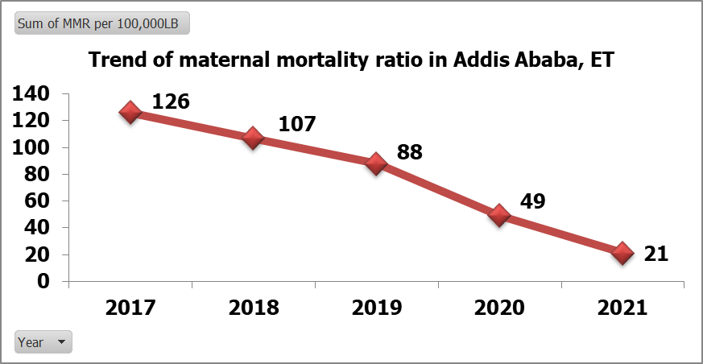
Results and …cont’d
MMR over the five year period was 77.16 per 100,000 live births
Limitation due to lack of appropriate denominator

Slide 11
Results and cont’d…
Causes of maternal death
Direct cause = 87%
Haemorrhage is the leading cause (50%), Hypertensive disorders in pregnancy (22%), puerperal sepsis (15%), and embolism (10%)
Indirect cause = 13%
Anaemia (56%), HIV/AIDS (32%) and TB (12%)

Slide 12
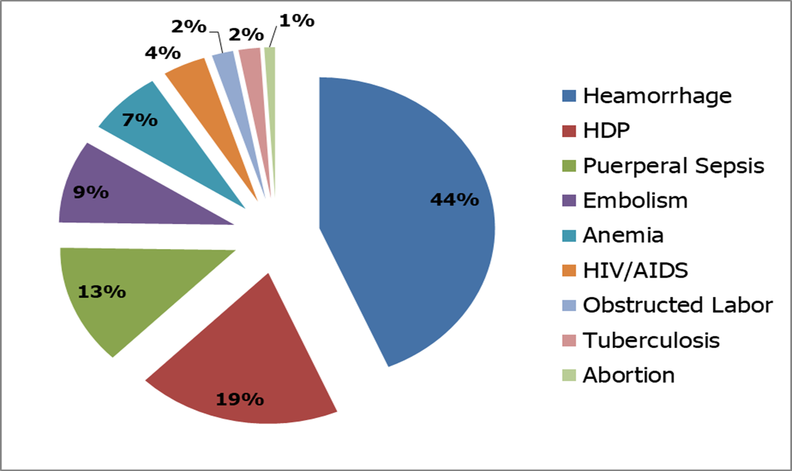
Results and cont’d…
Causes of Maternal Death, Addis Ababa, 2017-2021

Slide 13
Results and …cont’d
Contributing factors of maternal death
Over half, 184 (57%), of the deceased mothers faced delay in receiving care after reaching health facilities
Delay to seek care contributed for 34% of maternal deaths
Delay to reach health facilities contributed 24% of maternal deaths

Slide 14
Conclusions
Maternal mortality ratio has been declining in Addis Ababa over past five years
Majority of the maternal deaths are avoidable which is overwhelmingly due to the delays in providing quality care at health facilities

Slide 15
Recommendations
Improving maternity care system, focusing on the quality and scope of care available at existing facilities
Improving referral system, and other factors that hiders the women from seeking healthcare and reaching health facilities for obstetric care
Further investigations of the type II and III delays

Slide 16
Acknowledgment
Special thanks to:
Ethiopia Ministry of Health and FETP-Intermediate Stakeholders:
CDC,
AFENET,
EPHA
Ethiopian Public Health Institute

Slide 17
Thank you!!!

Slide 18
References
1. World Health Organization. International Statistical Classification of Diseases and Related Health Problems. -10th revision, Fifth edition [Internet]. Fifth. Vol. 1, World Health Organization. Geneva; 2016. Available from:http://www.who.int/classifications/icd/icdonlineversions/en/
2. World Health Organization. Trends in maternal mortality 2000 to 2017: estimates by WHO, UNICEF, UNFPA, World Bank Group and the Unites Nations Population Divisions. World Health Organization. Geneva; 2019.
3. Ethiopian Public Health Institute. National Technical Guidance for Maternal and Perinatal Death Surveillance and Response 2017 [Internet]. Addis Ababa; 2017. Available from: https://www.ephi.gov.et/images/pictures/National-Maternal-and-Perinatal--Death-Surveillance-and-Response-guidance-2017.pdf
4. Aden JA, Ahmed HJ, Östergren P. Causes and contributing factors of maternal mortality in Bosaso District of Somalia . A retrospective study of 30 cases using a Verbal Autopsy approach. Glob Health Action [Internet]. 2019;12(1):1672314. Available from: https://doi.org/10.1080/16549716.2019.1672314
5. Mgawadere F, Unkels R, Kazembe A, Broek N Van Den. Factors associated with maternal mortality in Malawi : application of the three delays model. BMC Pregnancy Childbirth. 2017;219(17):1–9.

